Slide 1
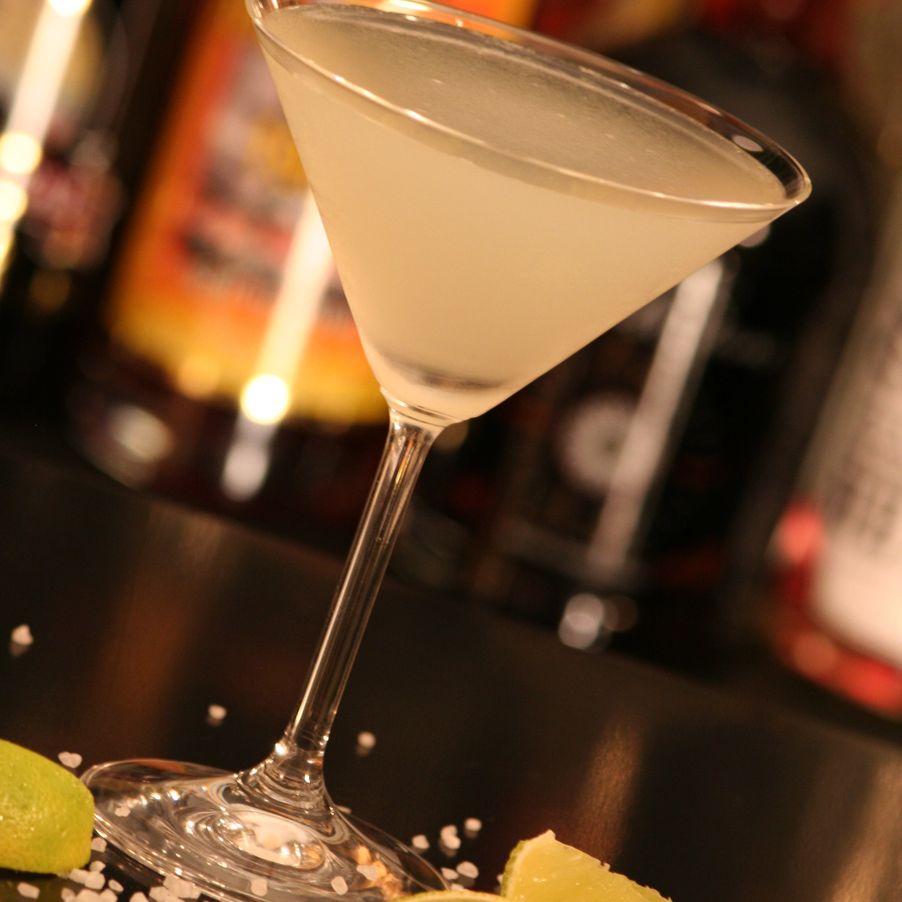
Drink Mixer
Random Drink
By Spirit
All Drinks
Add Drink
Random Drink
Click Here to Get a Random Drink
Drink Name
Ingredients:
Ingredient 1
Ingredient 2
Directions:
Make drink
Drink drink
Add drink

Slide 2
Drink Mixer
Random Drink
By Spirit
All Drinks
Add Drink
By Spirit
Alcohol List
Find Drink!
Drink #1
Drink #2
Drink #3
Add drink

Slide 3
Drink Mixer
Random Drink
By Spirit
All Drinks
Add Drink
Drink Name
Ingredients:
Ingredient 1
Ingredient 2
Directions:
Make drink
Drink drink
Add drink

Slide 4
Drink Mixer
Random Drink
By Spirit
All Drinks
Add Drink
All Drinks
Drink Name
Drink Name
Drink Name
Drink Name
Drink Name
Drink Name

Slide 5
Drink Mixer
Random Drink
By Spirit
All Drinks
Add Drink
Drink Name
Ingredients:
Ingredient 1
Ingredient 2
Directions:
Make drink
Drink drink
Comments

Slide 6
Drink Mixer
Random Drink
By Spirit
All Drinks
Add Drink
Add a Drink
Drink Image (Once tested)
Drink Name
Ingredients
Directions
Image
Test Image
Submit Drink

